Slide 1

MySQL database Create Data Lab
Victor Patterson Sr.

Slide 2

"SQL (Structured Query Language) is sort of a love language for talking to databases. You can use it to create, update, and delete data in a database. A database stores a large amount of data; think of it like a spreadsheet with columns. In a DBMS (Database Management System), the database is managed."

Slide 3
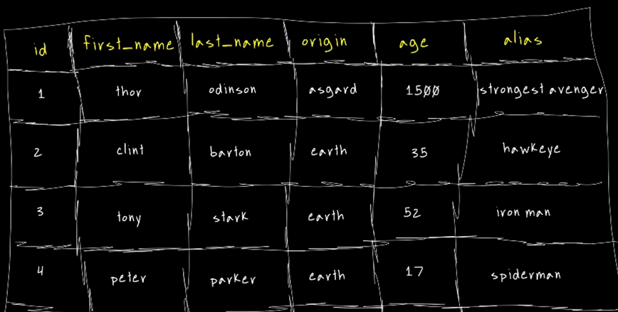
Data Base Types
1st Is Relational Data B
A way to understand is that you would have a related database
2nd the Non – relational Data is an unstructured database with use cases.

Slide 4
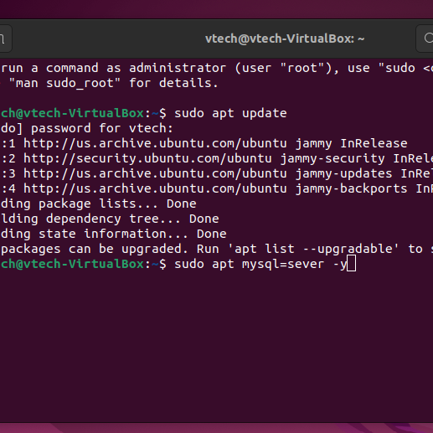
1st Step by step I launched my VM Oracle Linux machine ubuntu mint
*Open your Terminal and type the command - sudo apt update
The reason for the update needed is to show the repository update
Next Install MySQL
(sudo apt install mysql-server –y)
(-y)= means tick
*update as shown

Slide 5
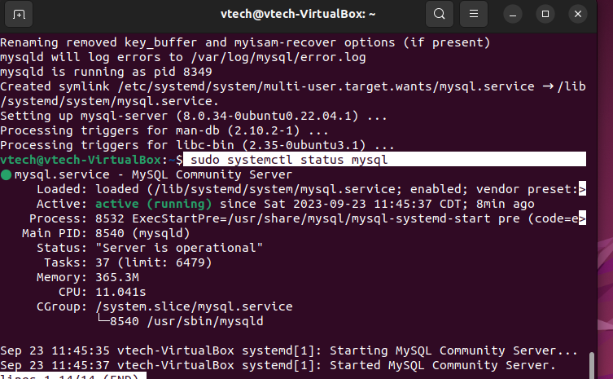
Check the status of mysql
To check the status of MySQL by command sudo systemctl status mysql

Slide 6
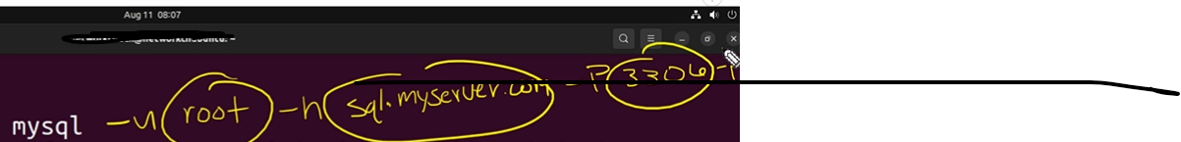
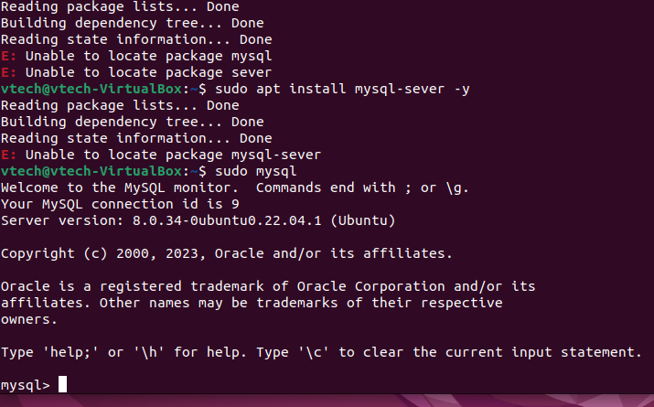
To Access MySQL type the command sudo mysql MySQL Should be running like this however this works b/c I am connected to my local host w/t no password as shown below in the near future, often you may see -u root for *user name* – sql.myserver.com *would be the remote server you would want to connect to* the - P 3306 is the Port number -p

Slide 7
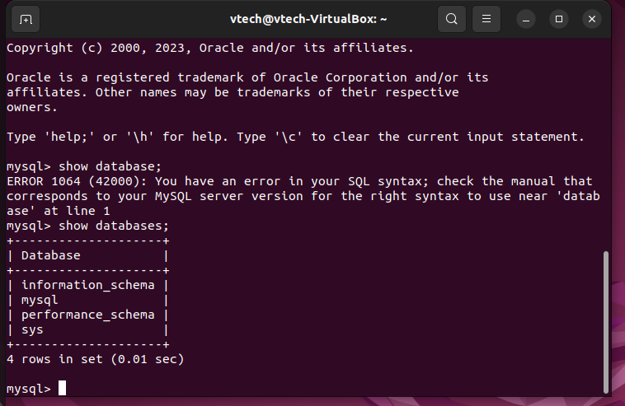
Next I checked current data bases
Command- show databases; side note anytime you use request a command you have to use a (;) and at the end of your command.

Slide 8
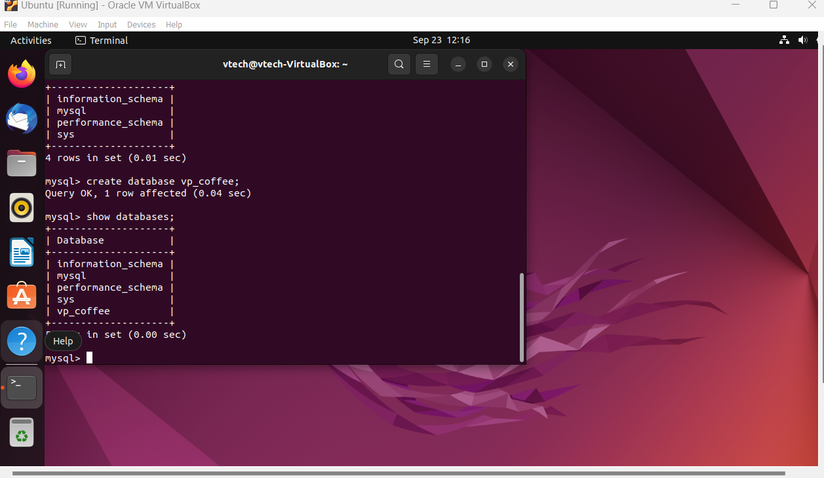
Created my own data base
I started my command create database vp_coffee;

Slide 9
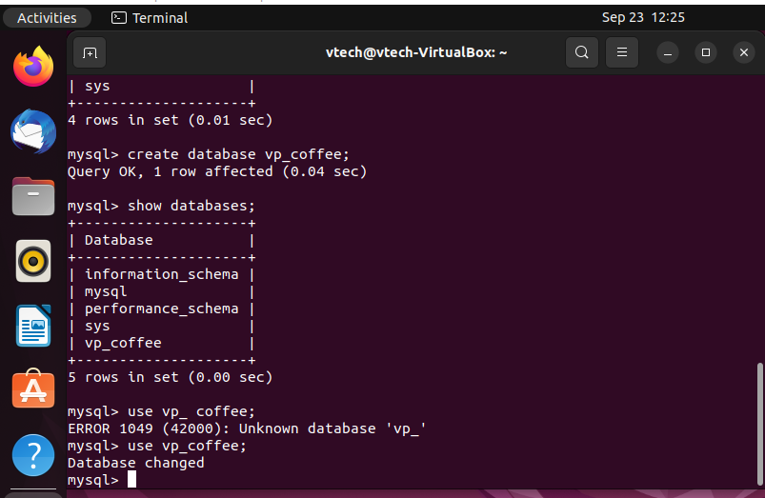
To use this current data base and interact with this data base
I used in mysql use vp_coffee;

Slide 10
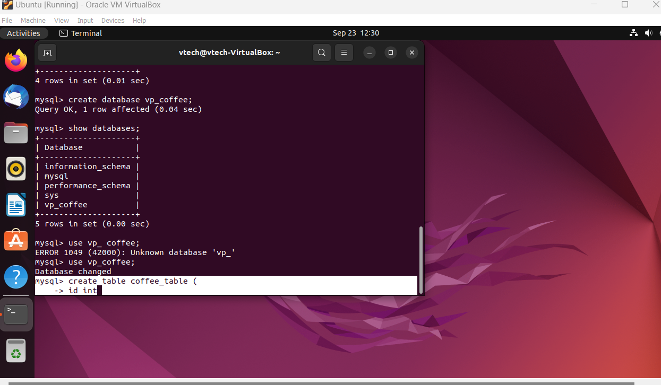
Mysql data base
What I did was created table in mysql by typing create table coffee_table(
Side note ( open parenthesis means your not finished with your command. My example shows this. ; means your done w/t that cmd.

Slide 11
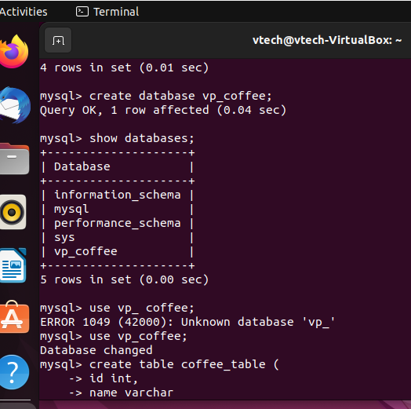
Defining the columns
I defined my columns by id int which defining the name of id in the name. The int defines what type of data is going to be in that column.
I also added a *name* called *varchar* which is end determinant length string data type.

Slide 12
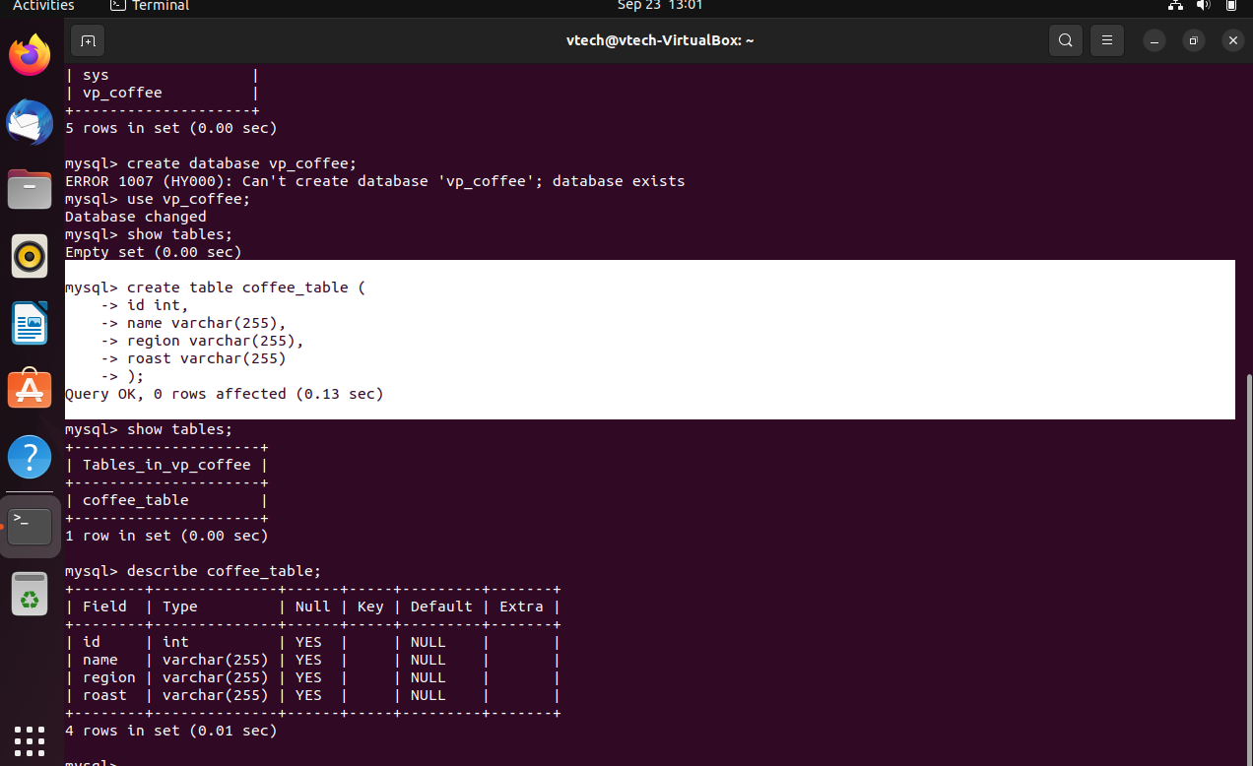
Continuing
Next I defined how long I wanted my characters to be allowed. I chose 255 *sidenote* varchar =variable characters

Slide 13
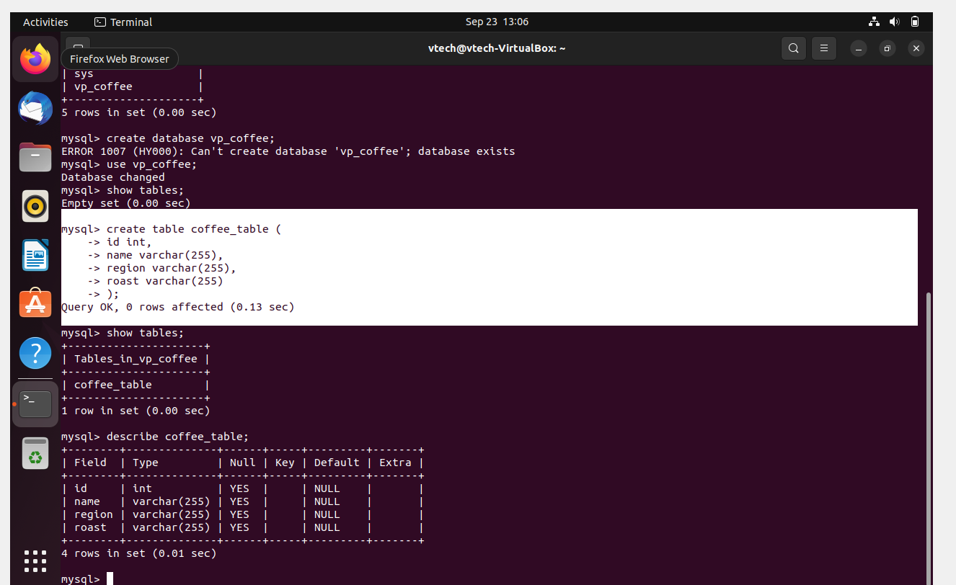
To check your table
Next I checked my table by typing *show tables;* but I also wanted to see my columns so I asked after verifying to describe coffee tables by asking to describe *coffee_table;*

Slide 14
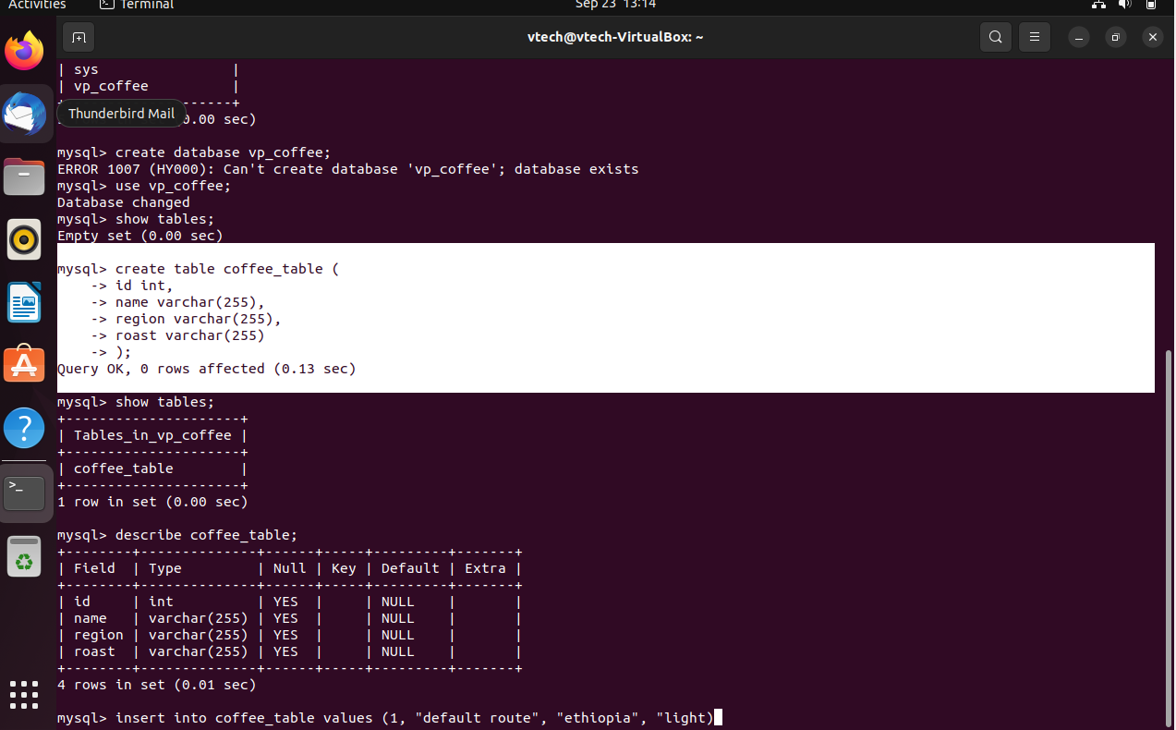
Continuation
Next in my table im telling mysql we’re inserting values into the coffee table. I have the ID the name, the region and the the roast

Slide 15
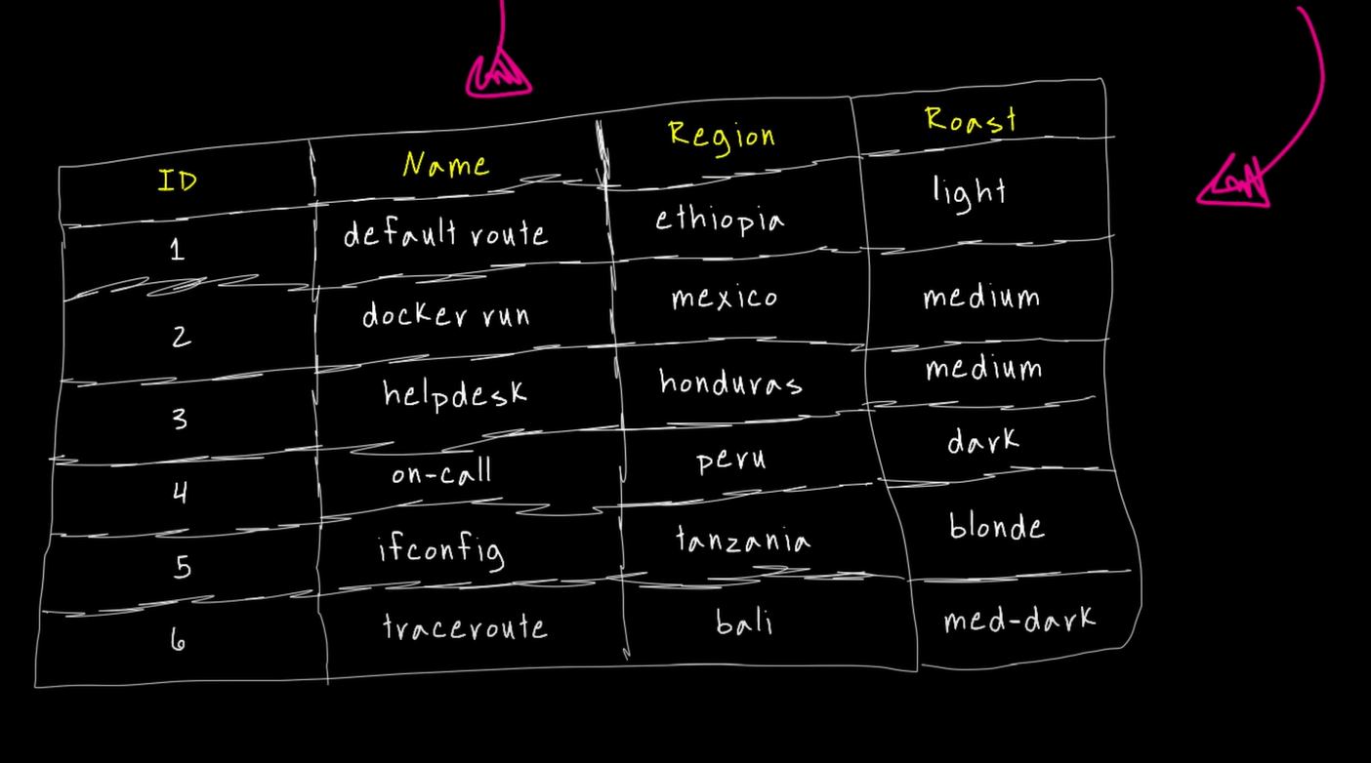
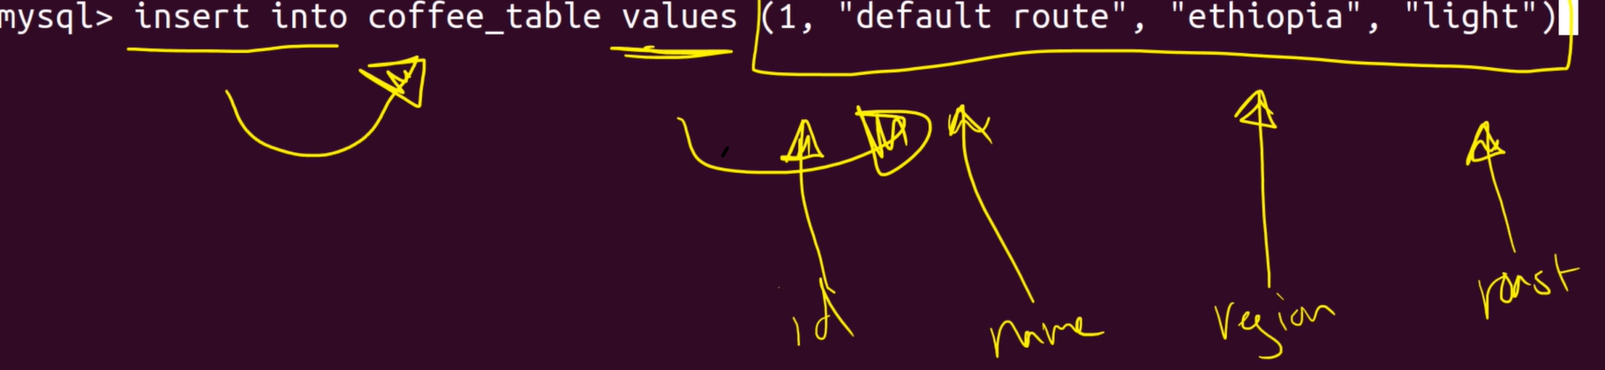
Adding more data to my database
In Order to have this hear is the values.
Command insert into coffee_table values (1, “default route, “Ethiopia”, “light”)

Slide 16
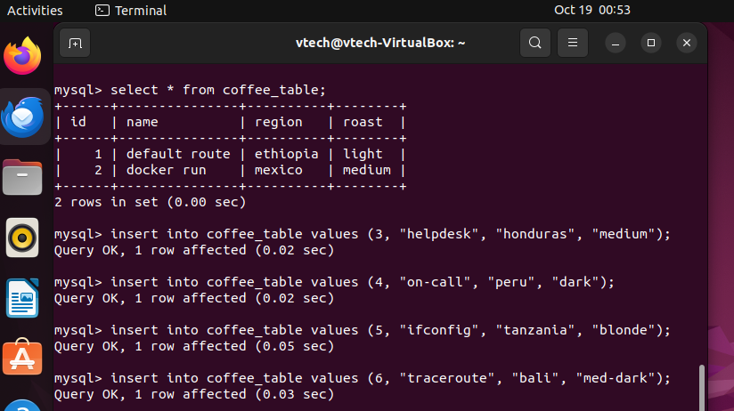
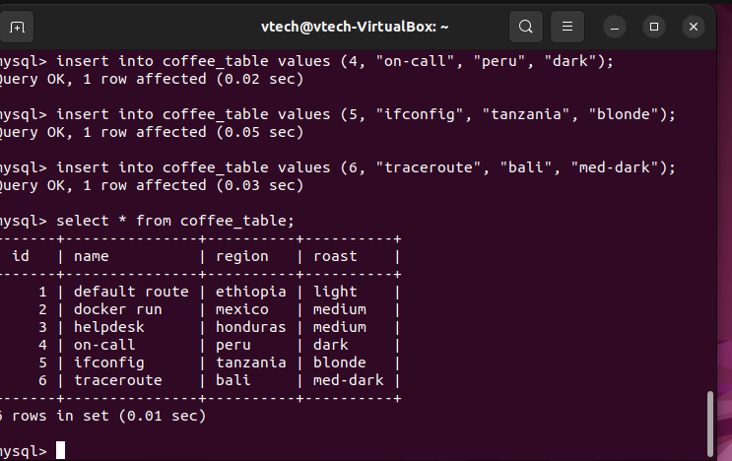
Adding tables
In continuations you I simply added rows by this cmd as showed. Your query should show ok if you perform your command correctly by it saying Query OK. I simply created a table inside the database and added some data to it.

Slide 17
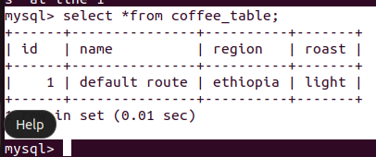
Interacting with my database pulling some data I typed the command select *from coffee_table; side note the * symbol means you want ALL YOUR CURRENT DATA from that specific table

Slide 18
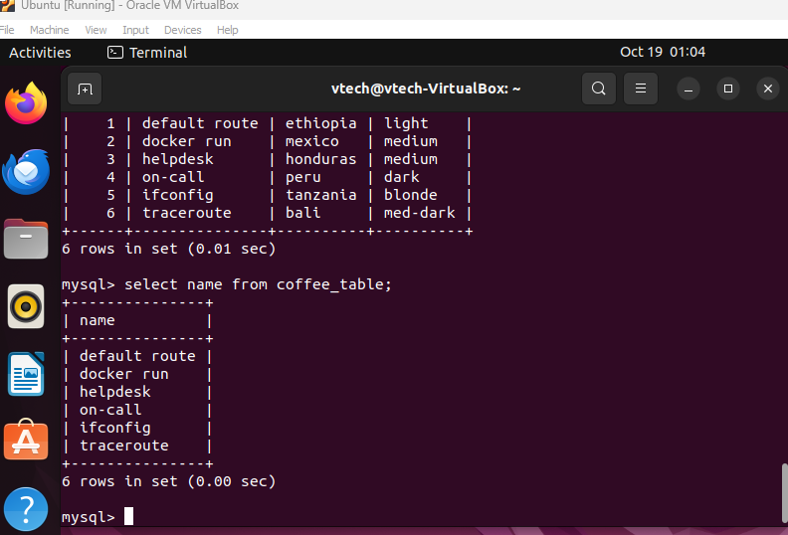
Specific Cololum
If I am to just select as specific from the Data base I used cmd select name from coffee_table;

